Slide 1
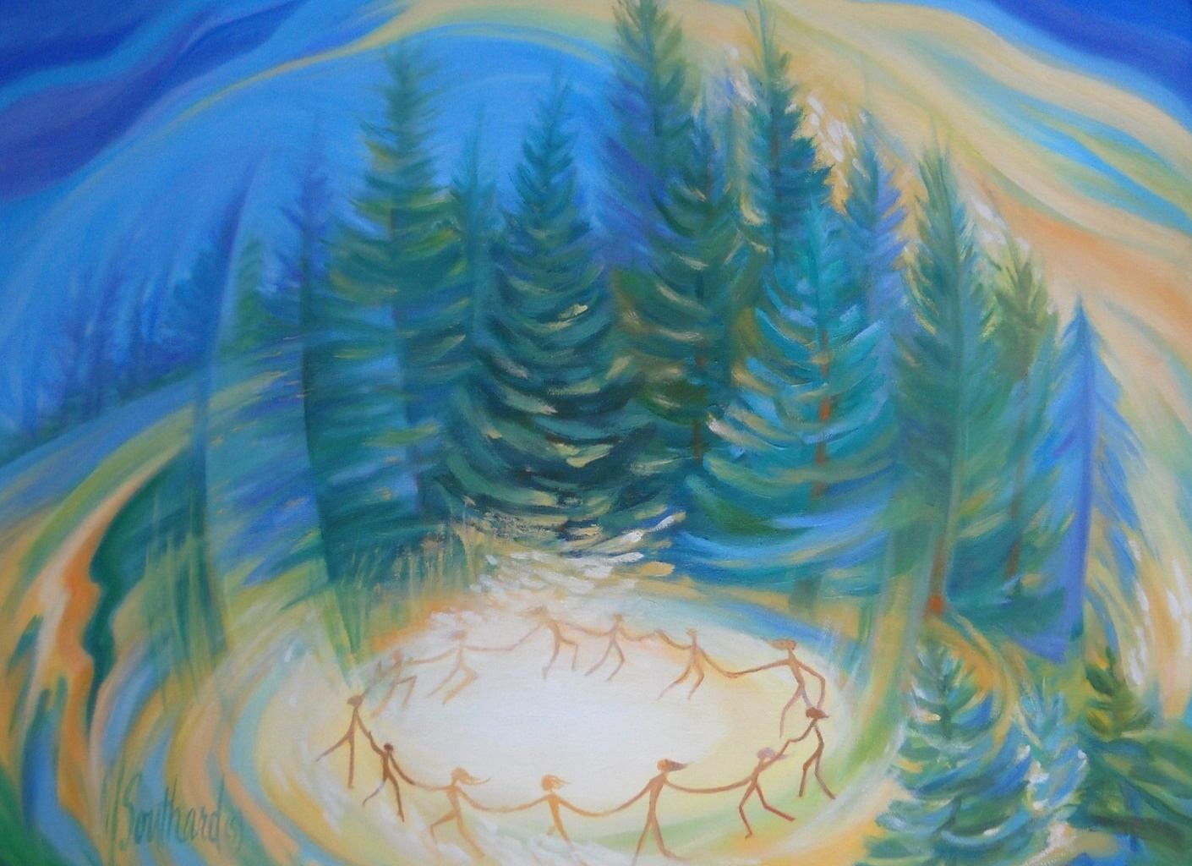
Shelley Graff &
Her Singing Circle Sisters
For All The Womyn

Slide 2
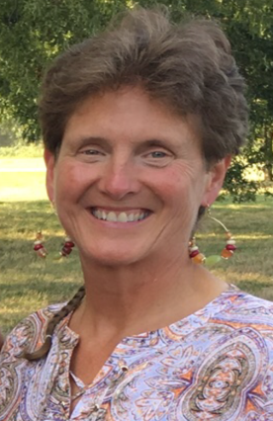
SHELLEY GRAFF
Web site: shelleyg.com
Email: shelleygraffmusic@gmail.com
Facebook: facebook.com/shelleygraffmusic
CDs:
~Moon Mama ~Fire On The Arrow ~Coming Home ~For All The Womyn
(Goldenrod.com)

