Slide 1
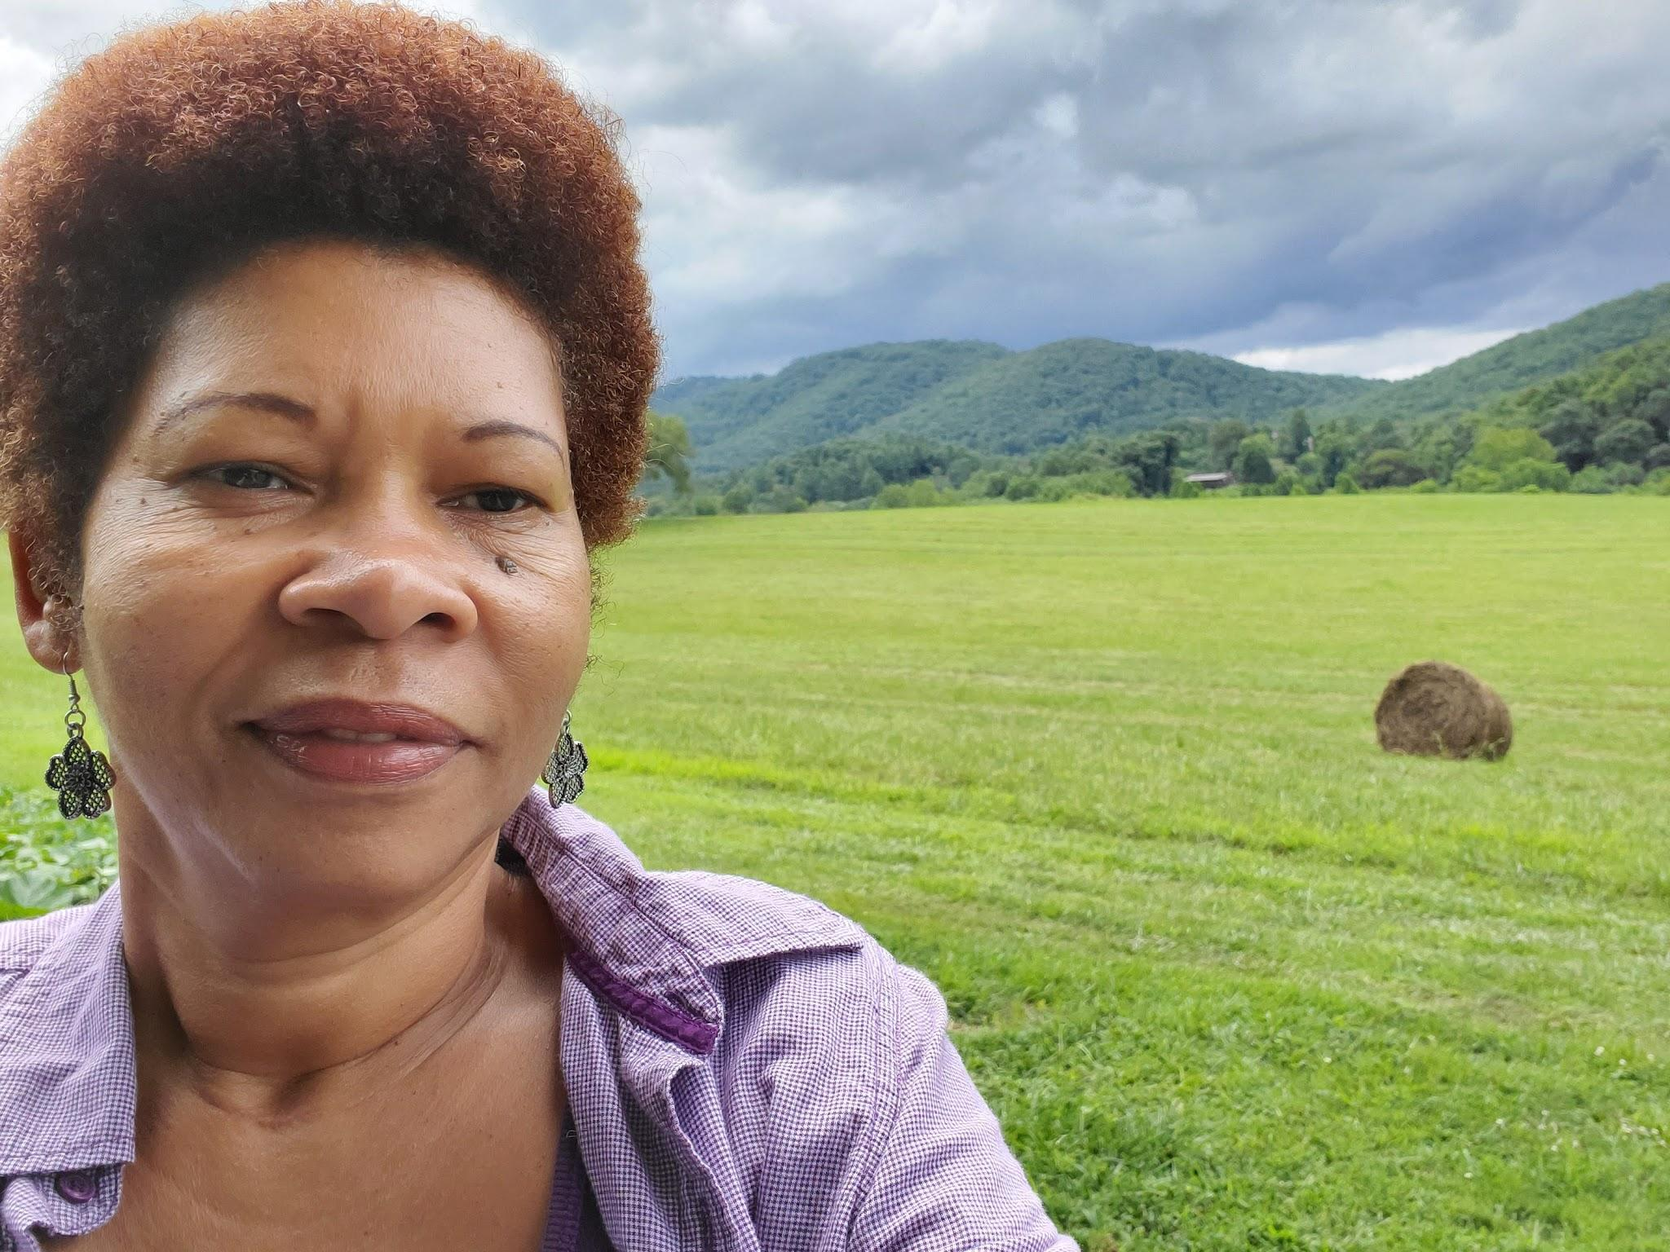
The Magic of Poetry
with Alberita (Albie) Johnson
www.alberitajohnson.com
Alberita (Albie) Johnson, Lover of Poetry, Holistic Coach, Guide and Minister has offered workshops such as: Poetry and Paganism shared at pagan festivals, Spoken Word and Poetry-SWFlorida local poets events, Women's Empowerment-ongoing workshops and Coaching, she has a passion for what is between the lines, and the magic of music. She has published poems and has wow awards for them.
This wonderful workshop combines two of my favorites, Magic and Poetry: What Happens when you mix poetry and magic, add a little rhythm and some percussion you have Spoken Word.

Slide 2
The Magic of Poetry
Overview
What Happens when you mix poetry and magic, add a little rhythm and some percussion you have Spoken Word. A form of succinct highs and lows shared during the reading/sharing of a poem. In this workshop we will participate in poetry drills, write your own short poem, and we hope to share it with the power of rhythmic drumming of a heartbeat in Spoken Word format, which I call swing. A powerful, dramatic performance that utilizes as many of the senses as possible. Thus offering an experiential element of sharing and receiving.

Slide 3
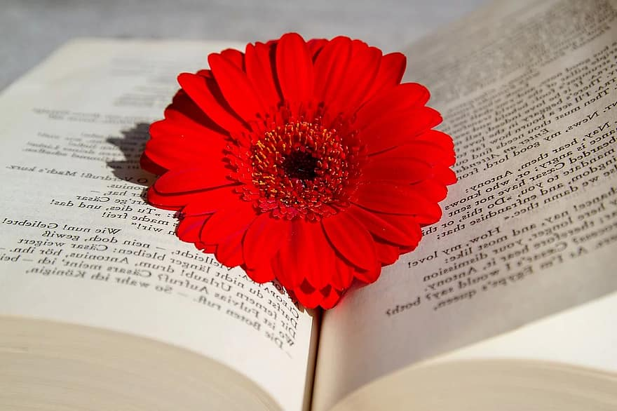
POEM BASICS
Rhythm, Rhyme and Imagery
Poetry, Spoken Word, Tone and Mood
Poetry, unlike other literary forms, focuses most sharply on Language itself.
Spoken Word Poetry, is a form of poetry that doesn’t have to rhyme, but certain parts can be rhymed to emphasize an image or give it a lyrical quality. Spoken word poems will sometimes contain elements of hip-hop, folk music, or jazz to enhance the rhythmic presentation.
Tone and Mood-The tone of a piece of literature is the speaker's or narrator's attitude towards the subject, rather than what the reader feels, as in mood. Mood is the general feeling or atmosphere that a piece of writing creates within the reader.

Slide 4
Poem: For Langston
Early Morning Dew
Kiss me
Wake me …
I am born
Midday Squall
Drench me
Soak me…
I am young
Evening Storms
Envelope me
Be my Cloak…
I am old
Waters of Heaven
Come down …
On me
Take me…I am home
By: Alberita Johnson

Slide 5
The last time is like the first Each time I see it It is new In the distance I see her rising Surging from the ashes of time Centuries of her memories Her first… A glimmer of the faithful And she was At first A church Yet not complete … | And another, and another Another century and another church She became layered, nine lives Rising tall, taller than all She is Cathedral Secrets of time buried in her Wars, Kings, and Conquerors Deep in her bowels Harmonies of old still lingering Soulful and sorrowful memories Heart wrenching and devastation pierce her soul She is Cathedral Hear the whispers of her towers | Peer through the windows of her eyes Feel her envelope and touch your soul Taste and experience her She is Cathedral Stand in awe of her Time itself is within her Dare to be filled with her She is Cathedral She hopes all things She bears all things She believes all things She is You

Slide 6
The last time is like the first time Each time I see her she is new In the distance I see her stature and sunlight upon her pastures they reflect her true colors, her emotions, her age, and her labors. She’s layered, a cat of nine lives She’s buried, wars, kings, and, conquerors Old harmonies still echo in her womb soulful and sorrowful, hymns of devastation and heart wrenching wounds Her Spires are filled with sour milk | Her Face is marred with panes of guilt And Nostrils hers are filled with dust and filth She Tastes of the vine and day old bread, and stale wine We came for her solace to experience her embrace to light three candles where past and present can never escape We kneel and remind her of her promise to shield us from the furnace to yield to us in earnest and to save us from our wake

Slide 7
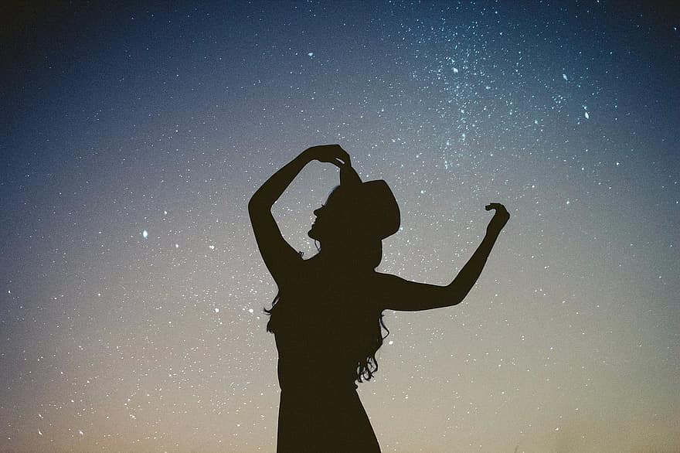
Poetry Drills
Going down the runway
Head held high
High stepping, Steppin high
Click, click, click
Lights flashing
DJ Spinnin
Spin darling, spin let your dress swirl
Going down the runway
Head held high
Balance baby
Keep your balance
Polka dots, yellow on black
Belted yellow
With Top Hat and yellow feather
Click, Click, Clank
Down, Down, Down
Still poised
Still Beautiful
Oh No
My Hat, My Hat
Hair
By Alberita Johnson

Slide 8
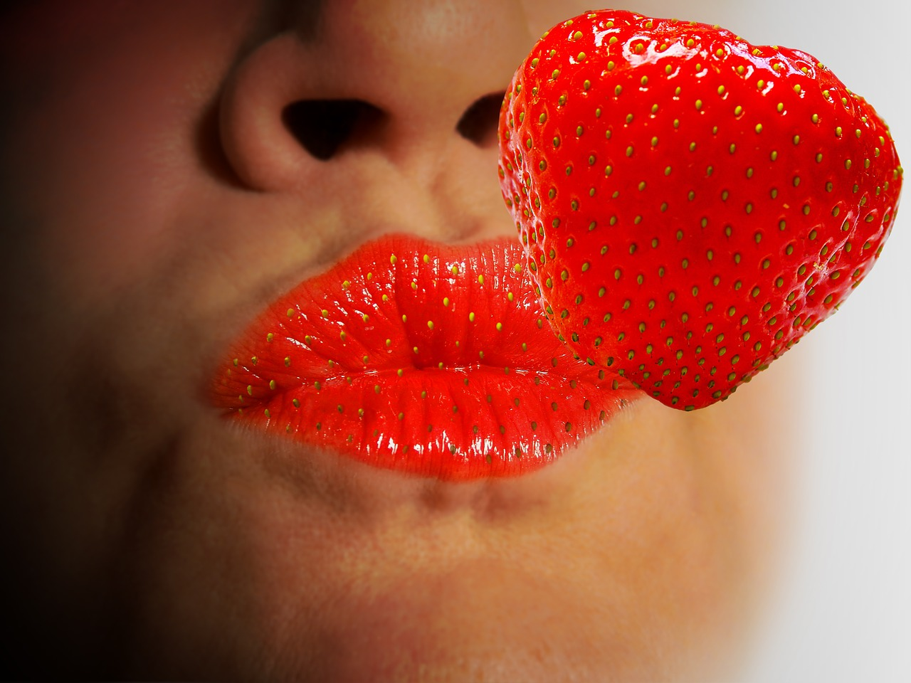
Thank You for sharing your time, and talent with me.
Let’s stay in-touch www.alberitajohnson.com
albiestalk@gmail.com
239 218-7405

